Slide 1

Pelatihan Statistika Dasar
Farit Mochamad Afendi
08128592194 – fmafendi@apps.ipb.ac.id
Otoritas Jasa Keuangan
Disampaikan pada:
Rabu-Jumat, 7-9 Agustus 2019
Jakarta

Slide 2
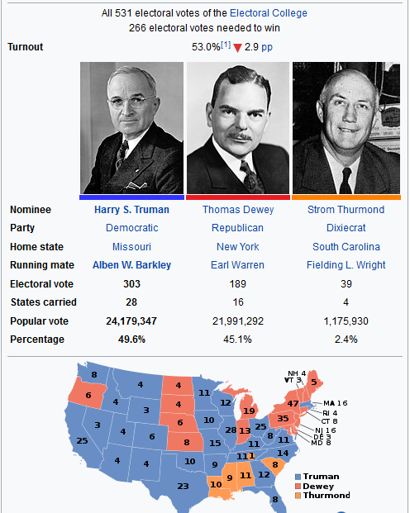

1948 US presidential election
When the Tribune revisited their poll to see what went wrong, they quickly discovered that they had oversampled Republicans in their data for a pretty simple reason: the poll was conducted entirely over the phone. Since wealthy people were more likely to have a phone and were also more likely to identify as Republican, the poll was skewed significantly towards Dewey. – Sampling Bias

Slide 3
Tipe pengumpulan data
Survei
Memotret kondisi objek
Derajat kausalitas lebih rendah dari percobaan
Percobaan
Prosedur manipulasi input dan atau proses untuk evaluasi pengaruh terhadap respon
Derajat kausalitas tertinggi
Studi observasional
Serupa dengan percobaan namun intervensi terbatas karena masalah etis
(Pengaruh merokok terhadap penyakit saluran pernafasan)
Data Sekunder

Slide 4

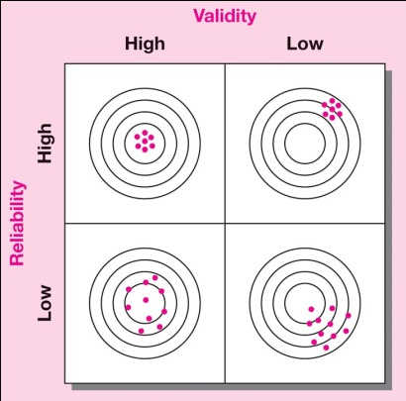
Kapan contoh dikatakan sahih?
Accurate:
Ketepatan
Precise:
Kecermatan
Ketepatan: derajat ketiadaan bias (perbedaan contoh dengan populasi)
Berkaitan dengan keterwakilan contoh
Kecermatan: derajat seberapa dekat contoh mewakili populasi
Berkaitan dengan kecukupan ukuran contoh

Slide 5
Bagaimana proses pengambilan contohnya?
Populasi 1
Rata-rata
Populasi 2
Total stok
1
3
1
4
2
2
3
3
2
4
4
4
5
6
4
3
1
1
7
8
9
20
16
20
10
11
12
17
17
19
20
17
13
14
114
109
15
112
106
μ = 8
N = 15
T=619
N=24

Slide 6


Bagaimana proses pengambilan contohnya?
Banyaknya populasi ikan
Banyaknya populasi pohon di hutan

Slide 7
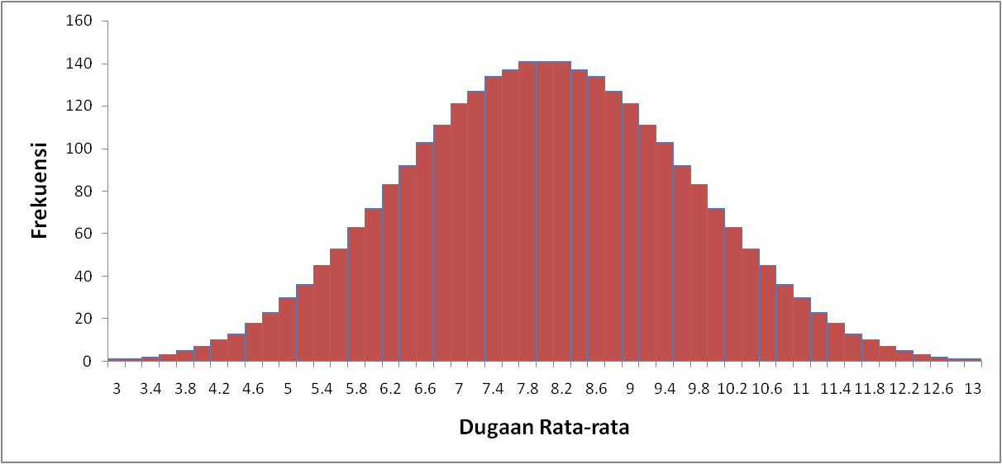
Percontohan dan Pendugaan
μ = 8
Populasi
1, 2, 3, 4, 5
1
2
3
4
6
1, 2, 3, 4, 6
5
7
8
9
10
11
12
. . .
13
14
15
11, 12, 13, 14, 15
μ = 8
N = 15

Slide 8
Tipe-tipe percontohan
Element Selection | Probability | Nonprobability
Unrestricted | Simple random | Convenience
Restricted | Complex random | Purposive
 | Systematic | Judgment
 | Cluster | Quota
 | Stratified | Snowball
 | Double

Slide 9
Probability sampling methods

Slide 10
Percontohan acak sederhana (simple random sampling) [1]
Proses pengacakan dilakukan langsung tanpa batasan apapun pada seluruh anggota populasi yang tertera dalam kerangka percontohan.
N = 45
n = 5
Angka acak: 67, 34, 41, 06, 09
No contoh: 22 (67-45), 34, 41, 6, 9
Tabel angka acak
57172 | 42088 | 70098
33883 | 87680 | 28923
77950 | 67344 | 10609
11607 | 11596 | 01796
56149 | 55678 | 38169
80719 | 65101 | 77729
93809 | 19505 | 82000
Permulaan pembacaan angka

Slide 11
Percontohan acak sederhana (simple random sampling) [2]
Advantages
Easy to implement with random dialing
Disadvantages
Requires list of population elements
Time consuming
Uses larger sample sizes
Produces larger errors
High cost

Slide 12
Percontohan acak sistematis (systematic random sampling) [1]
Proses pengacakan dilakukan tidak pada seluruh kerangka percontohan namun hanya pada pemilihan contoh pertama (pada rentang sampling fraction),
Pemilihan contoh berikutnya dilakukan dengan lompatan sistematis sejauh sampling fraction dari contoh sebelumnya.
N = 45
n = 5
Sampling fraction = N/n = 45/5 = 9
Angka acak: 6
No contoh: 6, 15 (6+9), 24 (15+9), 33 (24+9), 42 (33+9)
Tabel angka acak
57172 | 42088 | 70098
33883 | 87680 | 28923
77950 | 67344 | 10609
11607 | 11596 | 01796
56149 | 55678 | 38169
80719 | 65101 | 77729
93809 | 19505 | 82000
Permulaan pembacaan angka

Slide 13
Percontohan acak sistematis (systematic random sampling) [2]

Slide 14
Percontohan acak sistematis (systematic random sampling) [3]
Advantages
Simple to design
Easier than simple random
Easy to determine sampling distribution of mean or proportion
Disadvantages
Periodicity within population may skew sample and results
Trends in list may bias results
Moderate cost

Slide 15
Percontohan acak berlapis (stratified random sampling) [1]
Percontohan untuk menyiasati kondisi populasi yang beragam dengan membuat lapisan/subpopulasi/strata yang kondisinya seragam. Pemilihan contoh selanjutnya dilakukan pada tiap subpopulasi/ lapisan/ strata tersebut.
Basis pembuatan lapisan adalah faktor(-faktor) yang terkait dengan substansi permasalahan yang diangkat.

Slide 16
Ilustrasi
Consumers
Large Industry
Medium Industry
Demand on sugar
Small Industry
Household
X
Y

Slide 17
Percontohan acak berlapis (stratified random sampling) [2]
Advantages
Control of sample size in strata
Increased statistical efficiency
Provides data to represent and analyze subgroups
Enables use of different methods in strata
Disadvantages
Increased error will result if subgroups are selected at different rates
Especially expensive if strata on population must be created
High cost

Slide 18
Percontohan acak bergerombol (clustered random sampling) [1]
Percontohan untuk menyiasati kondisi populasi yang beragam dengan membuat subpopulasi/gerombol yang kondisinya heterogen.
Pemilihan contoh diawali dengan memilih cluster, dan seluruh anggota populasi pada cluster terpilih akan diambil.
Basis penggerombolan biasanya adalah kedekatan wilayah.

Slide 19
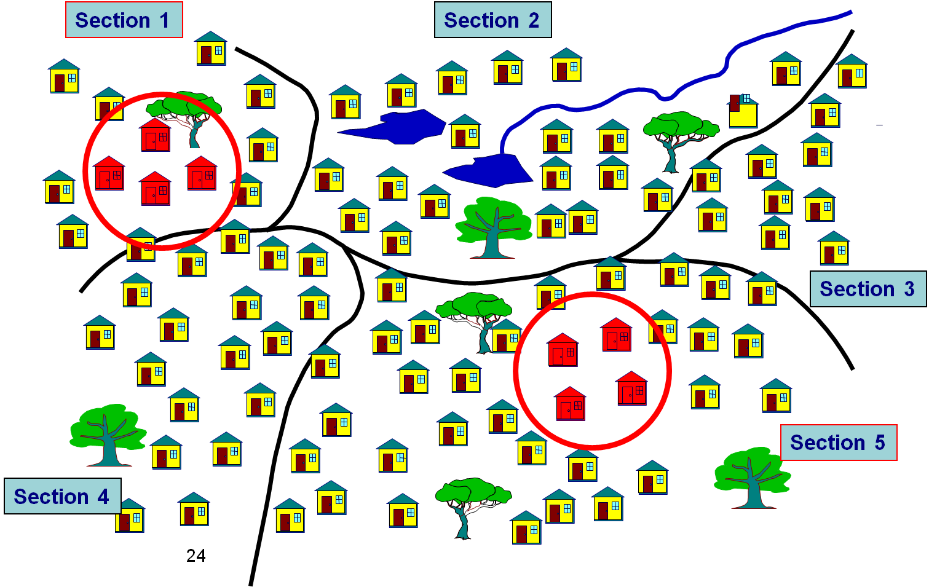
Ilustrasi

Slide 20
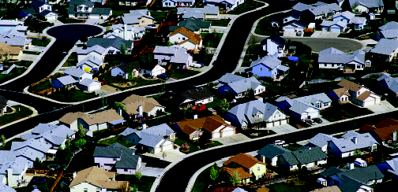
Ilustrasi: Area Sampling

Slide 21
Percontohan acak bergerombol (clustered random sampling) [2]
Advantages
Provides an unbiased estimate of population parameters if properly done
Economically more efficient than simple random
Lowest cost per sample
Easy to do without list
Disadvantages
Often lower statistical efficiency due to subgroups being homogeneous rather than heterogeneous
Moderate cost

Slide 22
Stratified and cluster sampling
Stratified
Population divided into few subgroups
Homogeneity within subgroups
Heterogeneity between subgroups
Choice of elements from within each subgroup
Cluster
Population divided into many subgroups
Heterogeneity within subgroups
Homogeneity between subgroups
Random choice of subgroups

Slide 23
Percontohan acak bertahap (multistage random sampling) [1]
Percontohan yang dilakukan bertahap sebelum pemilihan pemilihan target objek utama.
Prov
Quick count PILKADA
Kec
Kec
Kec
Kec
TPS
TPS
TPS
TPS

Slide 24
Percontohan acak bertahap (multistage random sampling) [2]
Advantages
May reduce costs if first stage results in enough data to stratify or cluster the population
Disadvantages
Increased costs if discriminately used
Increasing sampling error

Slide 25
Penentuan ukuran contoh

Slide 26
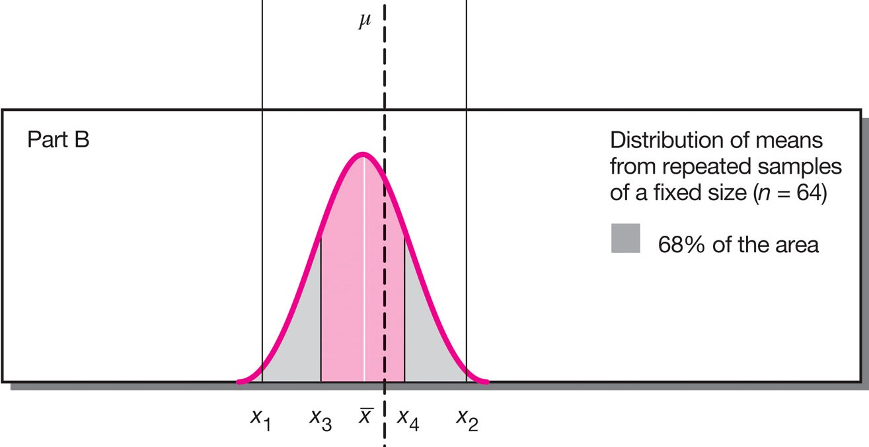
Sampling distribution – central limit theorem –
margin of error
galat baku (standard error)
-Z_{α/2}
Z_{α/2}

Slide 27
Faktor penentu ukuran contoh
Populasi takhingga (infinite population)
Populasi terhingga (finite population)
Tingkat kepercayaan
Keragaman populasi
Margin of error
Koreksi populasi terhingga
N = banyaknya anggota populasi
n = ukuran contoh
e = margin of error
σ² = keragaman populasi
Z_{α} = nilai kuantil normal pada taraf nyata α

Slide 28
Percontohan acak sederhana
Pendugaan rata-rata populasi
Pendugaan proporsi populasi (p)

Slide 29
Percontohan acak berlapis
Pendugaan rata-rata populasi
Pendugaan proporsi populasi
L = banyaknya lapisan
N_{i} = banyaknya anggota lapisan i
σ_{i}² = keragaman lapisan i
a_{i} = proporsi contoh dari lapisan i
p_{i} = proporsi peubah target dari lapisan i

Slide 30
Alokasi contoh di tiap lapisan [1]
Faktor yang diperhatikan:
Banyaknya anggota di tiap lapisan
Keragaman anggota dalam tiap lapisan
Biaya untuk mendapatkan anggota dari tiap lapisan

Slide 31
Alokasi contoh di tiap lapisan [2]
Alokasi optimum
Alokasi Neyman
Alokasi Proporsional

Slide 32
Percontohan acak bergerombol [1]
1
2
3
N = banyaknya gerombol di populasi
n = banyaknya gerombol terpilih secara acak sederhana
m_{i} = banyaknya anggota gerombol i, i = 1, 2, ..., N
4
5
6
rataan ukuran gerombol untuk gerombol terpilih
N = 6,
n = 3
m_{i} = 3, 5, 5, 4, 4, 4
banyaknya anggota populasi
rataan ukuran gerombol untuk seluruh gerombol

Slide 33
Percontohan acak bergerombol [2]
Pendugaan rata-rata populasi
1
2
3
4
5
6
Pendugaan proporsi populasi
N = 6,
n = 3
m_{i} = 3, 5, 5, 4, 4, 4

Slide 34
Strategi pemilihan contoh produktifitas hortikultura
Area Studi
Stratifikasi wilayah survei (kab/kec) menurut intensitas produktifitas
Strata 1
Strata 2
Strata 3
Pemilihan wilayah survei pada masing-masing strata
wilayah terpilih
wilayah terpilih
wilayah terpilih
Identifikasi obyek survei pada masing-masing wilayah survei terpilih. Perbarui daftarnya sebagai kerangka percontohan.
Tipe A
Tipe B
Tipe C
Pemilihan obyek survei pada masing-masing tipe (besar/sedang/kecil)
Contoh
Contoh
Contoh

Slide 35
Panel Data
Panel data (also known as longitudinal or cross-sectional time-series data) is a dataset in which the behavior of entities are observed across time. These entities could be states, companies, individuals, countries, etc.
Panel data looks like this
Country | Year | Y | X1 | X2 | X3
1 | 2000 | 6 | 7.8 | 5.8 | 1.3
1 | 2001 | 4.6 | 0.6 | 7.9 | 7.8
1 | 2002 | 9.4 | 2.1 | 5.4 | 1.1
2 | 2000 | 9.1 | 1.3 | 6.7 | 4.1
2 | 2001 | 8.3 | 0.9 | 6.6 | 5
2 | 2002 | 0.6 | 9.8 | 0.4 | 7.2
3 | 2000 | 9.1 | 0.2 | 2.6 | 6.4
3 | 2001 | 4.8 | 5.9 | 3.2 | 6.4
3 | 2002 | 9.1 | 5.2 | 6.9 | 2.1
Notes:
For a brief introduction on the theory behind panel data analysis please see the following document: http://dss.princeton.edu/training/Panel101.pdf The contents of this document rely heavily on the document: “Panel Data Econometrics in R: the plm package” http://cran.r-project.org/web/packages/plm/vignettes/plm.pdf and notes from the ICPSR’s Summer Program in Quantitative Methods of Social Research (summer 2010)

Slide 36
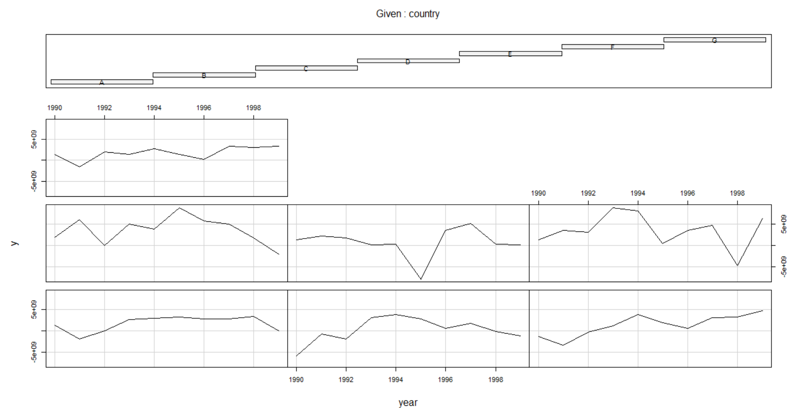
Exploring Panel Data
library(foreign) Panel <- read.dta("http://dss.princeton.edu/training/Panel101.dta") coplot(y ~ year|country, type="l", data=Panel) # Lines coplot(y ~ year|country, type="b", data=Panel) # Points and lines
Notes:
# Bars at top indicates corresponding graph (i.e. countries) from left to right starting on the bottom row (Muenchen/Hilbe:355)

Slide 37
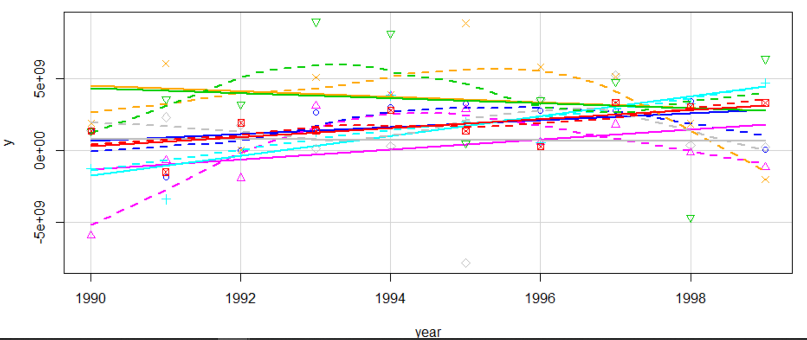
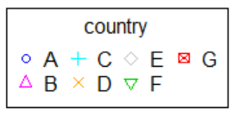
Exploring Panel Data
library(car)
scatterplot(y~year|country, boxplots=FALSE, smooth=TRUE, reg.line=FALSE, data=Panel)

Slide 38
FIXED-EFFECTS MODEL (Covariance Model, Within Estimator, Individual Dummy Variable Model, Least Squares Dummy Variable Model)

Slide 39
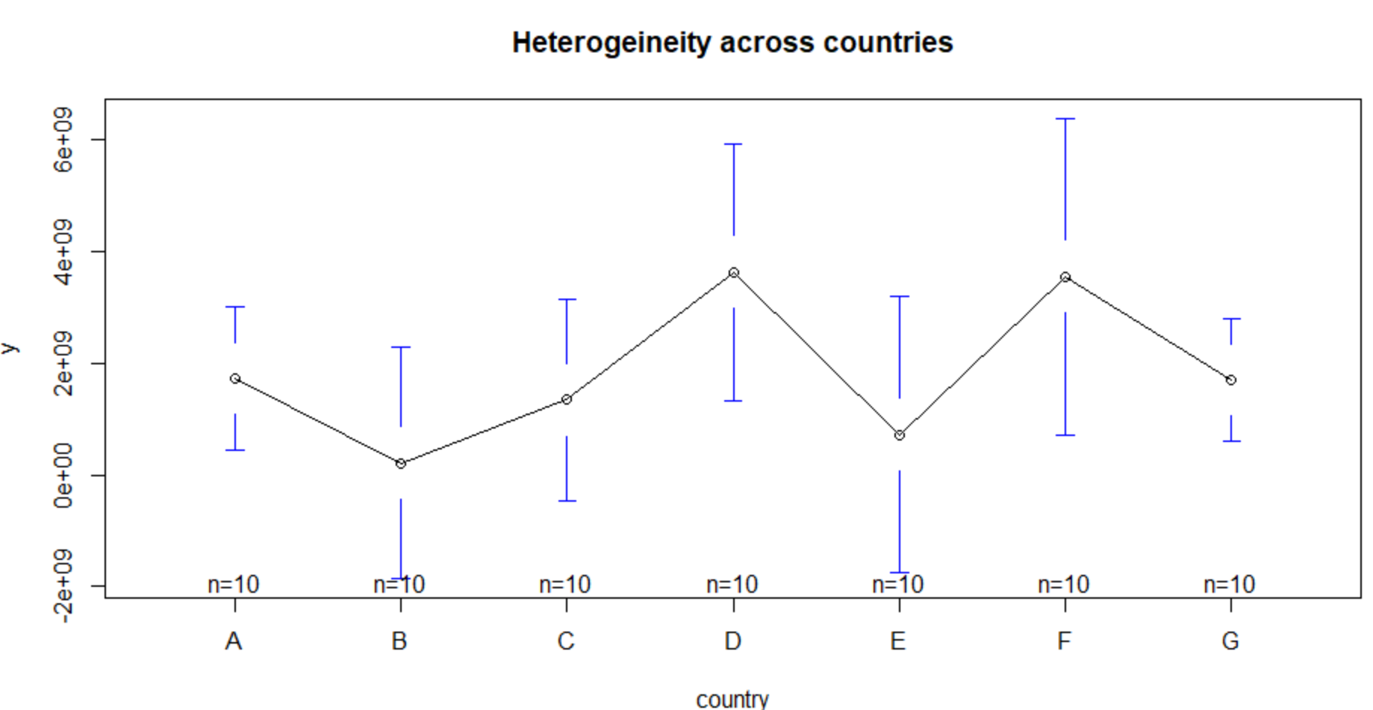
Fixed effects: Heterogeneity across countries (or entities)
library(gplots)
plotmeans(y ~ country, main="Heterogeineity across countries", data=Panel)
Heterogeneity: unobserved variables that do not change over time

Slide 40
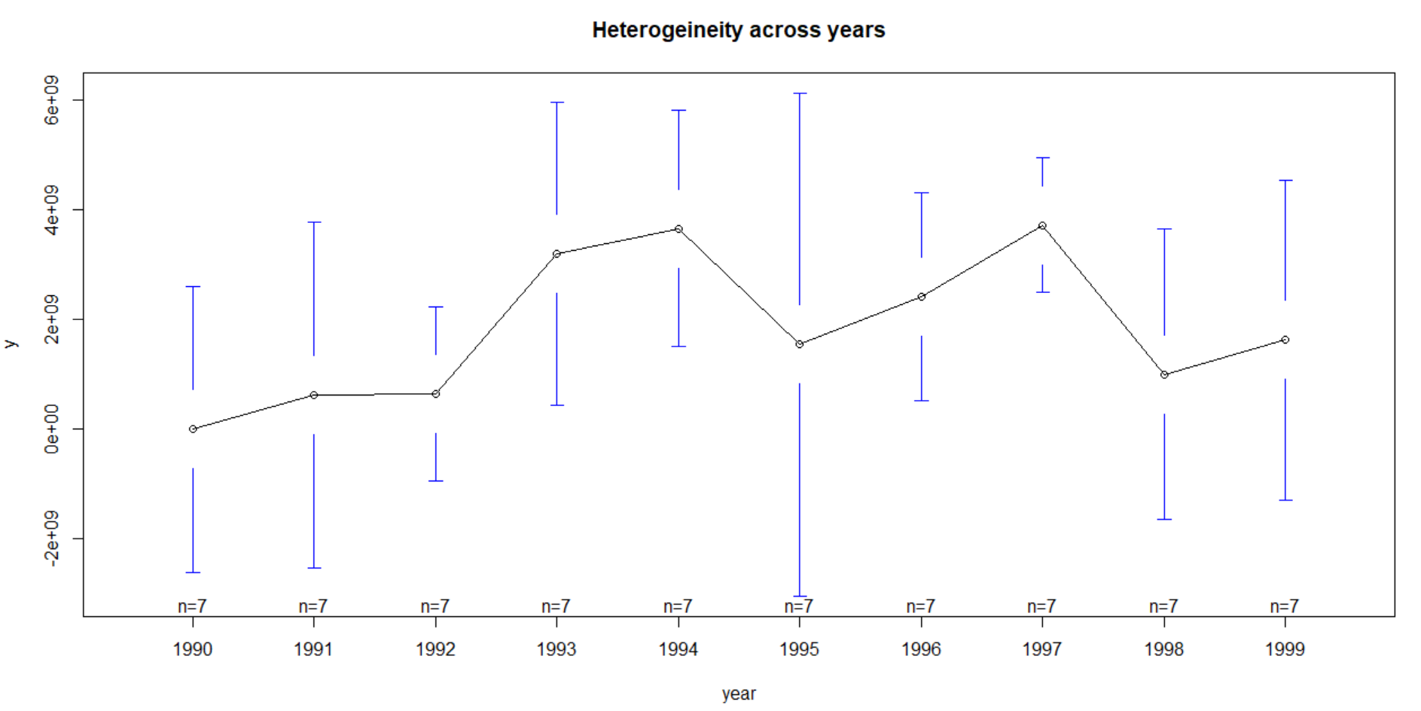
Fixed effects: Heterogeneity across years
plotmeans(y ~ year, main="Heterogeineity across years", data=Panel)
Heterogeneity: unobserved variables that do not change over time

Slide 41
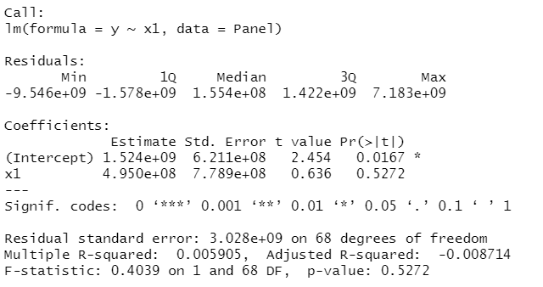
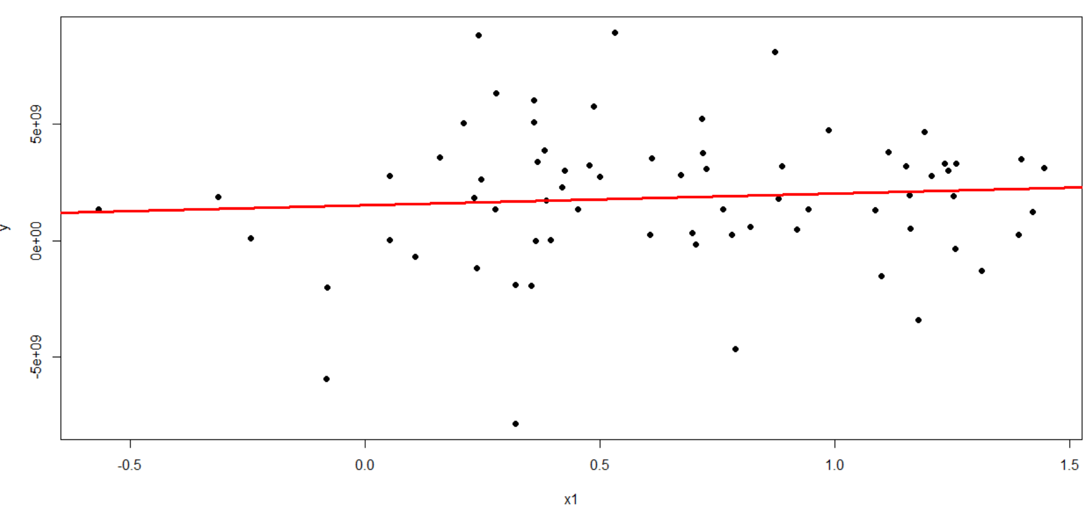
OLS Regression
ols <-lm(y ~ x1, data=Panel) summary(ols) yhat <- ols$fitted plot(Panel$x1, Panel$y, pch=19, xlab="x1", ylab="y") abline(lm(Panel$y~Panel$x1),lwd=3, col="red")
Regular OLS regression does not consider heterogeneity across groups or time

Slide 42
Fixed effects using Least squares dummy variable model
fixed.dum <-lm(y ~ x1 + factor(country) - 1, data=Panel)
summary(fixed.dum)
Call:
lm(formula = y ~ x1 + factor(country) - 1, data = Panel)
Residuals:
Min 1Q Median 3Q Max
-8.634e+09 -9.697e+08 5.405e+08 1.386e+09 5.612e+09
Coefficients:
Estimate Std. Error t value Pr(>|t|)
x1 2.476e+09 1.107e+09 2.237 0.02889 *
factor(country)A 8.805e+08 9.618e+08 0.916 0.36347
factor(country)B -1.058e+09 1.051e+09 -1.006 0.31811
factor(country)C -1.723e+09 1.632e+09 -1.056 0.29508
factor(country)D 3.163e+09 9.095e+08 3.478 0.00093 ***
factor(country)E -6.026e+08 1.064e+09 -0.566 0.57329
factor(country)F 2.011e+09 1.123e+09 1.791 0.07821 .
factor(country)G -9.847e+08 1.493e+09 -0.660 0.51190
---
Signif. codes: 0 ‘***’ 0.001 ‘**’ 0.01 ‘*’ 0.05 ‘.’ 0.1 ‘ ’ 1
Residual standard error: 2.796e+09 on 62 degrees of freedom
Multiple R-squared: 0.4402, Adjusted R-squared: 0.368
F-statistic: 6.095 on 8 and 62 DF, p-value: 8.892e-06
Notes:
For the theory behind fixed effects, please see http://dss.princeton.edu/training/Panel101.pdf

Slide 43
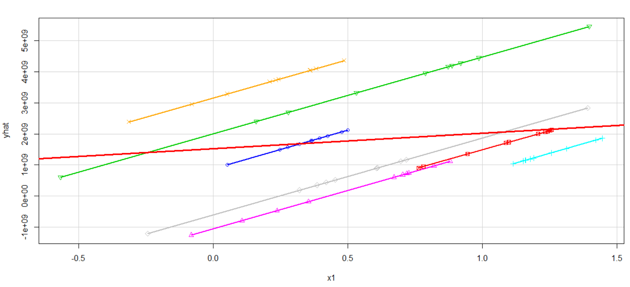
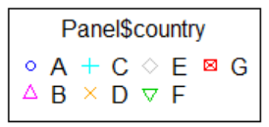
Least squares dummy variable model
yhat <- fixed.dum$fitted
library(car)
scatterplot(yhat~Panel$x1|Panel$country, boxplots=FALSE, xlab="x1", ylab="yhat",smooth=FALSE)
abline(lm(Panel$y~Panel$x1),lwd=3, col="red")
OLS regression
OLS regression

Slide 44
Comparing OLS vs LSDV model
Each component of the factor variable (country) is absorbing the effects particular to each country. Predictor x1 was not significant in the OLS model, once controlling for differences across countries, x1 became significant in the OLS_DUM (i.e. LSDV model).
library(apsrtable)
apsrtable(ols,fixed.dum, model.names = c("OLS", "OLS_DUM")) # Displays a table in Latex form
& \multicolumn{ 1 }{ c }{ OLS } & \multicolumn{ 1 }{ c }{ OLS_DUM } \\ \hline
% & OLS & OLS_DUM \\
(Intercept) & 1524319070.05 ^* & \\
& (621072623.86) & \\
x1 & 494988913.90 & 2475617827.10 ^*\\
& (778861260.95) & (1106675593.60) \\
factor(country)A & & 880542403.99 \\
& & (961807052.24) \\
factor(country)B & & -1057858363.16 \\
& & (1051067684.19) \\
factor(country)C & & -1722810754.55 \\
& & (1631513751.40) \\
factor(country)D & & 3162826897.32 ^*\\
& & (909459149.66) \\
factor(country)E & & -602622000.33 \\
& & (1064291684.41) \\
factor(country)F & & 2010731793.24 \\
& & (1122809097.35) \\
factor(country)G & & -984717493.45 \\
& & (1492723118.24) \\
$N$ & 70 & 70 \\
$R^2$ & 0.01 & 0.44 \\
adj. $R^2$ & -0.01 & 0.37 \\
Resid. sd & 3028276248.26 & 2795552570.60 \\ \hline
\multicolumn{3}{l}{\footnotesize{Standard errors in parentheses}}\\
\multicolumn{3}{l}{\footnotesize{$^*$ indicates significance at $p< 0.05 $}}
\end{tabular}
\end{table}
The coefficient of much Y changes when x1 indicates how X increases by one unit. Notice x1 is not significant in
the OLS model
The coefficient of x1 indicates how much Y changes overtime, controlling by differences in countries, when X increases by one unit. Notice x1 is significant in the LSDV model

Slide 45
Fixed effects: n entity-specific intercepts (using plm)
Outcome Variable
Panel setting
Fixed effects option
library(plm)
fixed <- plm(y ~ x1, data=Panel, index=c("country", "year"), model="within")
summary(fixed)
Oneway (individual) effect Within Model
Call:
plm(formula = y ~ x1, data = Panel, model = "within", index = c("country",
"year"))
Balanced Panel: n = 7, T = 10, N = 70
Residuals:
Min. 1st Qu. Median Mean 3rd Qu. Max.
-8.63e+09 -9.70e+08 5.40e+08 0.00e+00 1.39e+09 5.61e+09
Coefficients:
Estimate Std. Error t-value Pr(>|t|)
x1 2475617827 1106675594 2.237 0.02889 *
---
Signif. codes: 0 ‘***’ 0.001 ‘**’ 0.01 ‘*’ 0.05 ‘.’ 0.1 ‘ ’ 1
Total Sum of Squares: 5.2364e+20
Residual Sum of Squares: 4.8454e+20
R-Squared: 0.074684
Adj. R-Squared: -0.029788
F-statistic: 5.00411 on 1 and 62 DF, p-value: 0.028892
Predictor
variable(s)
n = # of groups/panels, T = # years, N = total # of observations
The coeff of x1 indicates how much Y changes overtime, on average per country, when X increases by one unit
Pr(>|t|)= Two-tail p-values test the hypothesis that each coefficient is different from 0. To reject this, the p-value has to be lower than 0.05 (95%, you could choose also an alpha of 0.10), if this is the case then you can say that the variable has a significant influence on your dependent variable (y)
If the p-value is < 0.05 then the fixed effects model is a better choice

Slide 46
Fixed effects: n entity-specific intercepts (using plm)
fixef(fixed) # Display the fixed effects (constants for each country)
A B C D E F G
880542404 -1057858363 -1722810755 3162826897 -602622000 2010731793 -984717493
pFtest(fixed, ols) # Testing for fixed effects, null: OLS better than fixed
F test for individual effects
data: y ~ x1
F = 2.9655, df1 = 6, df2 = 62, p-value = 0.01307
alternative hypothesis: significant effects
If the p-value is < 0.05 then the fixed effects model is a better choice

Slide 47
RANDOM-EFFECTS MODEL (Random Intercept, Partial Pooling Model)
random <- plm(y ~ x1, data=Panel, index=c("country", "year"), model="random")
summary(random)
Oneway (individual) effect Random Effect Model
(Swamy-Arora's transformation)
Call:
plm(formula = y ~ x1, data = Panel, model = "random", index = c("country",
"year"))
Balanced Panel: n = 7, T = 10, N = 70
Effects:
var std.dev share
idiosyncratic 7.815e+18 2.796e+09 0.873
individual 1.133e+18 1.065e+09 0.127
theta: 0.3611
Residuals:
Min. 1st Qu. Median Mean 3rd Qu. Max.
-8.94e+09 -1.51e+09 2.82e+08 0.00e+00 1.56e+09 6.63e+09
Coefficients:
Estimate Std. Error z-value Pr(>|z|)
(Intercept) 1037014284 790626206 1.3116 0.1896
x1 1247001782 902145601 1.3823 0.1669
Total Sum of Squares: 5.6595e+20
Residual Sum of Squares: 5.5048e+20
R-Squared: 0.02733
Adj. R-Squared: 0.013026
Chisq: 1.91065 on 1 DF, p-value: 0.16689
random effects option
n = # of groups/panels, T = # years, N = total # of observations
Interpretation of the coefficients is tricky since they include both the within-entity and between-entity effects. In the case of TSCS data represents the average effect of X over Y when X changes across time and between countries by one unit.
Pr(>|t|)= Two-tail p-values test the hypothesis that each coefficient is different from 0. To reject this, the p-value has to be lower than 0.05 (95%, you could choose also an alpha of 0.10), if this is the case then you can say that the variable has a significant influence on your dependent variable (y)
If this number is < 0.05 then your model is ok. This is a test
(F) to see whether all the coefficients in the model are different than zero.

Slide 48
RANDOM-EFFECTS MODEL (Random Intercept, Partial Pooling Model)
# Setting as panel data (an alternative way to run the above model
Panel.set <- plm.data(Panel, index = c("country", "year"))
# Random effects using panel setting (same output as above)
random.set <- plm(y ~ x1, data = Panel.set, model="random")
summary(random.set)
Oneway (individual) effect Random Effect Model
(Swamy-Arora's transformation)
Call:
plm(formula = y ~ x1, data = Panel.set, model = "random")
Balanced Panel: n = 7, T = 10, N = 70
Effects:
var std.dev share
idiosyncratic 7.815e+18 2.796e+09 0.873
individual 1.133e+18 1.065e+09 0.127
theta: 0.3611
Residuals:
Min. 1st Qu. Median Mean 3rd Qu. Max.
-8.94e+09 -1.51e+09 2.82e+08 0.00e+00 1.56e+09 6.63e+09
Coefficients:
Estimate Std. Error z-value Pr(>|z|)
(Intercept) 1037014284 790626206 1.3116 0.1896
x1 1247001782 902145601 1.3823 0.1669
Total Sum of Squares: 5.6595e+20
Residual Sum of Squares: 5.5048e+20
R-Squared: 0.02733
Adj. R-Squared: 0.013026
Chisq: 1.91065 on 1 DF, p-value: 0.16689

Slide 49
Fixed or Random: Hausman test
To decide between fixed or random effects you can run a Hausman test where the null hypothesis is that the preferred model is random effects vs. the alternative the fixed effects (see Green, 2008, chapter 9). It basically tests whether the unique errors (ui) are correlated with the regressors, the null hypothesis is they are not.
Run a fixed effects model and save the estimates, then run a random model and save the estimates, then perform the test. If the p-value is significant (for example <0.05) then use fixed effects, if not use random effects.
> phtest(fixed, random)
Hausman Test
data: y ~ x1
chisq = 3.674, df = 1, p-value = 0.05527
alternative hypothesis: one model is inconsistent
If this number is < 0.05 then use fixed effects

Slide 50
Testing for time-fixed effects
fixed <- plm(y ~ x1, data=Panel, index=c("country", "year"), model="within")
fixed.time <- plm(y ~ x1 + factor(year), data=Panel, index=c("country", "year"), model="within")
summary(fixed.time)
Oneway (individual) effect Within Model
Call:
plm(formula = y ~ x1 + factor(year), data = Panel, model = "within",
index = c("country", "year"))
Balanced Panel: n = 7, T = 10, N = 70
Residuals:
Min. 1st Qu. Median Mean 3rd Qu. Max.
-7.92e+09 -1.05e+09 -1.40e+08 0.00e+00 1.63e+09 5.49e+09
Coefficients:
Estimate Std. Error t-value Pr(>|t|)
x1 1389050354 1319849567 1.0524 0.29738
factor(year)1991 296381559 1503368528 0.1971 0.84447
factor(year)1992 145369666 1547226548 0.0940 0.92550
factor(year)1993 2874386795 1503862554 1.9113 0.06138 .
factor(year)1994 2848156288 1661498927 1.7142 0.09233 .
factor(year)1995 973941306 1567245748 0.6214 0.53698
factor(year)1996 1672812557 1631539254 1.0253 0.30988
factor(year)1997 2991770063 1627062032 1.8388 0.07156 .
factor(year)1998 367463593 1587924445 0.2314 0.81789
factor(year)1999 1258751933 1512397632 0.8323 0.40898
---
Signif. codes: 0 ‘***’ 0.001 ‘**’ 0.01 ‘*’ 0.05 ‘.’ 0.1 ‘ ’ 1
Total Sum of Squares: 5.2364e+20
Residual Sum of Squares: 4.0201e+20
R-Squared: 0.23229
Adj. R-Squared: 0.00052851
F-statistic: 1.60365 on 10 and 53 DF, p-value: 0.13113

Slide 51
Testing for time-fixed effects
# Testing time-fixed effects. The null is that no time-fixed effects needed
pFtest(fixed.time, fixed)
F test for individual effects
data: y ~ x1 + factor(year)
F = 1.209, df1 = 9, df2 = 53, p-value = 0.3094
alternative hypothesis: significant effects
plmtest(fixed, c("time"), type=("bp"))
Lagrange Multiplier Test - time effects (Breusch-Pagan) for balanced panels
data: y ~ x1
chisq = 0.16532, df = 1, p-value = 0.6843
alternative hypothesis: significant effects
If this number is < 0.05 then use time-fixed effects. In this example, no need to use time-fixed effects.

Slide 52
Testing for random effects: Breusch-Pagan Lagrange multiplier (LM)
# Regular OLS (pooling model) using plm
pool <- plm(y ~ x1, data=Panel, index=c("country", "year"), model="pooling")
summary(pool)
Pooling Model
Call:
plm(formula = y ~ x1, data = Panel, model = "pooling",
index = c("country", "year"))
Balanced Panel: n = 7, T = 10, N = 70
Residuals:
Min. 1st Qu. Median Mean 3rd Qu. Max.
-9.55e+09 -1.58e+09 1.55e+08 0.00e+00 1.42e+09 7.18e+09
Coefficients:
Estimate Std. Error t-value Pr(>|t|)
(Intercept) 1524319070 621072624 2.4543 0.01668 *
x1 494988914 778861261 0.6355 0.52722
---
Signif. codes: 0 ‘***’ 0.001 ‘**’ 0.01 ‘*’ 0.05 ‘.’ 0.1 ‘ ’ 1
Total Sum of Squares: 6.2729e+20
Residual Sum of Squares: 6.2359e+20
R-Squared: 0.0059046
Adj. R-Squared: -0.0087145
F-statistic: 0.403897 on 1 and 68 DF, p-value: 0.52722
The LM test helps you decide between a random effects regression and a simple OLS regression. The null hypothesis in the LM test is that variances across entities is zero. This is, no significant difference across units (i.e. no panel effect)

Slide 53
Testing for random effects: Breusch-Pagan Lagrange multiplier (LM)
# Breusch-Pagan Lagrange Multiplier for random effects. Null is no panel effect (i.e. OLS better) plmtest(pool, type=c("bp")
Lagrange Multiplier Test - (Breusch-Pagan) for balanced panels
data: y ~ x1
chisq = 2.6692, df = 1, p-value = 0.1023
alternative hypothesis: significant effects)
Here we failed to reject the null and conclude that random effects is not appropriate. This is, no evidence of significant differences across countries, therefore you can run a simple OLS regression.

Slide 54
Testing for cross-sectional dependence/contemporaneous correlation: using Breusch-Pagan LM test of independence and Pasaran CD test
According to Baltagi, cross-sectional dependence is a problem in macro panels with long time series. This is not much of a problem in micro panels (few years and large number of cases).
The null hypothesis in the B-P/LM and Pasaran CD tests of independence is that residuals across entities are not correlated. B-P/LM and Pasaran CD (cross-sectional dependence) tests are used to test whether the residuals are correlated across entities*. Cross sectional dependence can lead to bias in tests results (also called contemporaneous correlation).
fixed <- plm(y ~ x1, data=Panel, index=c("country", "year"), model="within")
pcdtest(fixed, test = c("lm"))
Breusch-Pagan LM test for cross-sectional dependence in panels
data: y ~ x1
chisq = 28.914, df = 21, p-value = 0.1161
alternative hypothesis: cross-sectional dependence
pcdtest(fixed, test = c("cd")) Pesaran CD test for cross-sectional dependence in panels
data: y ~ x1
z = 1.1554, p-value = 0.2479
alternative hypothesis: cross-sectional dependence
No cross-sectional dependence

Slide 55
Testing for serial correlation
Serial correlation tests apply to macro panels with long time series. Not a problem in micro panels (with very few years). The null is that there is not serial correlation.
> pbgtest(fixed)
Breusch-Godfrey/Wooldridge test for serial correlation in panel models
data: y ~ x1
chisq = 14.137, df = 10, p-value = 0.1668
alternative hypothesis: serial correlation in idiosyncratic errors
No serial correlation

Slide 56
Testing for unit roots/stationarity
The Dickey-Fuller test to check for stochastic trends. The null hypothesis is that the series has a unit root (i.e. non-stationary). If unit root is present you can take the first difference of the variable.
Panel.set <- plm.data(Panel, index = c("country", "year"))
library(tseries)
adf.test(Panel.set$y, k=2)
Augmented Dickey-Fuller Test
data: Panel.set$y
Dickey-Fuller = -3.9051, Lag order = 2, p-value = 0.0191
alternative hypothesis: stationary
If p-value < 0.05 then no unit roots present.

Slide 57
Testing for heteroskedasticity
The null hypothesis for the Breusch-Pagan test is homoskedasticity.
If hetersokedaticity is detected you can use robust covariance matrix to account for it. See the following pages.
library(lmtest)
bptest(y ~ x1 + factor(country), data = Panel, studentize=F) Breusch-Pagan test
data: y ~ x1 + factor(country)
BP = 14.606, df = 7, p-value = 0.04139
Presence of heteroskedasticity

Slide 58
Controlling for heteroskedasticity: Robust covariance matrix estimation (Sandwich estimator)
The --vcovHC– function estimates three heteroskedasticity-consistent covariance estimators:
• "white1" - for general heteroskedasticity but no serial correlation. Recommended for random effects.
• "white2" - is "white1" restricted to a common variance within groups. Recommended for random effects.
• "arellano" - both heteroskedasticity and serial correlation. Recommended for fixed effects.
The following options apply*:
• HC0 - heteroskedasticity consistent. The default.
• HC1,HC2, HC3 – Recommended for small samples. HC3 gives less weight to influential observations.
• HC4 - small samples with influential observations
• HAC - heteroskedasticity and autocorrelation consistent (type ?vcovHAC for more details)

Slide 59
Controlling for heteroskedasticity: Random effects
random <- plm(y ~ x1, data=Panel, index=c("country", "year"), model="random")
coeftest(random) # Original coefficients
t test of coefficients:
Estimate Std. Error t value Pr(>|t|)
(Intercept) 1037014284 790626206 1.3116 0.1941
x1 1247001782 902145601 1.3823 0.1714
coeftest(random, vcovHC) # Heteroskedasticity consistent coefficients
t test of coefficients:
Estimate Std. Error t value Pr(>|t|)
(Intercept) 1037014284 907983029 1.1421 0.2574
x1 1247001782 828970247 1.5043 0.1371
coeftest(random, vcovHC(random, type = "HC3")) # Heteroskedasticity consistent coefficients, type 3
t test of coefficients:
Estimate Std. Error t value Pr(>|t|)
(Intercept) 1037014284 943438284 1.0992 0.2756
x1 1247001782 867137585 1.4381 0.1550

Slide 60
Controlling for heteroskedasticity: Random effects
# The following shows the HC standard errors of the coefficients
t(sapply(c("HC0", "HC1", "HC2", "HC3", "HC4"), function(x) sqrt(diag(vcovHC(random, type = x)))))
(Intercept) x1
HC0 907983029 828970247
HC1 921238957 841072643
HC2 925403820 847733474
HC3 943438284 867137584
HC4 941376033 866024033
Standard errors given different types of HC.

Slide 61
Controlling for heteroskedasticity: Fixed effects
fixed <- plm(y ~ x1, data=Panel, index=c("country", "year"), model="within")
coeftest(fixed) # Original coefficients
t test of coefficients:
Estimate Std. Error t value Pr(>|t|)
x1 2475617827 1106675594 2.237 0.02889 *
---
Signif. codes: 0 ‘***’ 0.001 ‘**’ 0.01 ‘*’ 0.05 ‘.’ 0.1 ‘ ’ 1
coeftest(fixed, vcovHC) # Heteroskedasticity consistent coefficients
t test of coefficients:
Estimate Std. Error t value Pr(>|t|)
x1 2475617827 1358388942 1.8225 0.07321 .
---
Signif. codes: 0 ‘***’ 0.001 ‘**’ 0.01 ‘*’ 0.05 ‘.’ 0.1 ‘ ’ 1

Slide 62
Controlling for heteroskedasticity: Fixed effects
# Heteroskedasticity consistent coefficients (Arellano)
coeftest(fixed, vcovHC(fixed, method = "arellano"))
t test of coefficients:
Estimate Std. Error t value Pr(>|t|)
x1 2475617827 1358388942 1.8225 0.07321 .
---
Signif. codes: 0 ‘***’ 0.001 ‘**’ 0.01 ‘*’ 0.05 ‘.’ 0.1 ‘ ’ 1
# Heteroskedasticity consistent coefficients, type 3
coeftest(fixed, vcovHC(fixed, type = "HC3"))
t test of coefficients:
Estimate Std. Error t value Pr(>|t|)
x1 2475617827 1439083523 1.7203 0.09037 .
---
Signif. codes: 0 ‘***’ 0.001 ‘**’ 0.01 ‘*’ 0.05 ‘.’ 0.1 ‘ ’ 1
# The following shows the HC standard errors of the coefficients
t(sapply(c("HC0", "HC1", "HC2", "HC3", "HC4"), function(x) sqrt(diag(vcovHC(fixed, type = )))))
HC0.x1 HC1.x1 HC2.x1 HC3.x1 HC4.x1
[1,] 1358388942 1358388942 1358388942 1358388942 1358388942
Standard errors given different types of HC.

Slide 63
TERIMA KASIH

